Slide 1
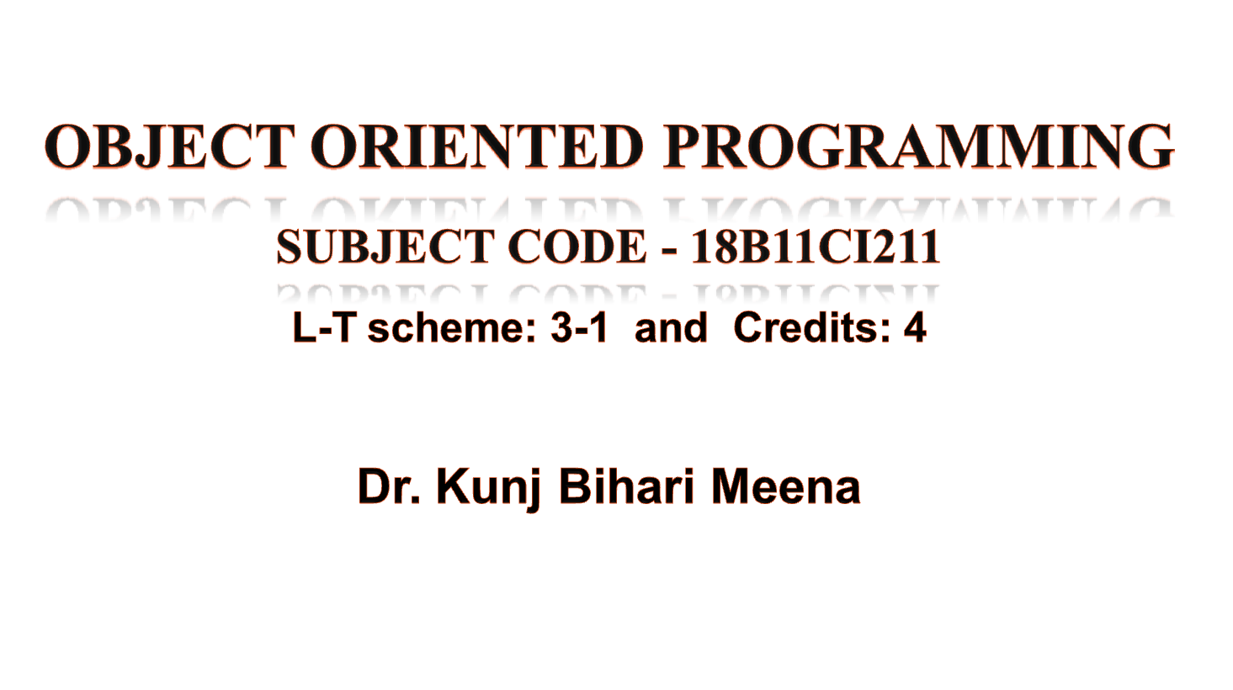

Slide 2
Prerequisites and Objectives
Prerequisites
Students must know basics of “Software Development Fundamentals”
Objectives
To introduce object oriented concepts in C++.
To strengthen the problem solving ability by applying the characteristics of object-oriented approach.

Slide 3
Course Outcomes
18B11CI211: Object Oriented Programming
Course Outcome | Description
CO1 | List various principles of Object-Oriented Programming (OOP).
CO2 | Describe the real world problems using object-oriented programming concepts.
CO3 | Develop the programs using the fundamental concepts of OOP.
CO4 | Identify and use various techniques used in OOP.
CO5 | Apply techniques used in OOP to solve the software design problems on a given software project.
CO6 | Demonstrate the learning on the course to solve the real life programming problems.

Slide 4
Course Content
Unit-1: Review of Structured programming in C, Structured versus Object-Oriented Programming, Principles of Object-Oriented Programming, Beginning with C++, Control Structures, Functions in C++, Reference Variables, Default Parameters, Function Overloading, Inline Function, and Const Variables.
Unit-2: Classes, Member Functions, Objects, Static Data Members, Static Member Functions, Friend Functions, Pointer to Members, Local classes, Constructors and Destructors
Unit-3: Operator overloading, Inheritance and its form, Multiple Inheritance in C++, Function Overriding, Diamond Problem, Virtual Base Class.
Unit-4: Pointers, Early binding, late binding, Type of polymorphism, Virtual, Abstract Class, Virtual Destructor Functions.
Unit-5: File handling, Exception handling.
Unit-6: Templates, Function templates, Class templates, Introduction to Standard Template Library (STL), Sequence, Containers, Iterators.

Slide 5
Evaluation Scheme (OOP)
Evaluations | Marks | Remarks
T-1 | 15 Marks (1-Hours) | 1st - 4th Week
T-2 | 25 Marks (1:30 Hours) | 5th - 10th Week
T-3 | 35 Marks (2-Hours) | 11th - 16th Week
Tutorials | 5 Marks
Assignments | 10 Marks
Quiz | 5 Marks
Attendance | 5 Marks
Total | 100 Marks

Slide 6
Evaluation Scheme (OOP Lab)
Component & Nature | Duration | Marks / Weightage
P1 (Mid sem lab – Viva/Test) | 2 hrs | 15
P2 (Mid sem lab – Viva/Test) | 2 hrs | 15
Continuous Evaluation(Lab work ) |  | 40
Lab record |  | 15
Attendance & discipline in lab |  | 15
Total |  | 100

Slide 7
Books
Text books
Text Book1: “Object oriented programming in C++” by Robert Lafore
Text Book2: “Object Oriented Programming with C++” by E Balagurusamy
References
“C++ Primer (5th Edition)” by S. B. Lippman
“The C++ Programming Language” by Bjarne Stroustrup
“Programming: Principles and Practice Using C++” by Bjarne Stroustrup

Slide 8
Object Oriented Programming
An Introduction

Slide 9
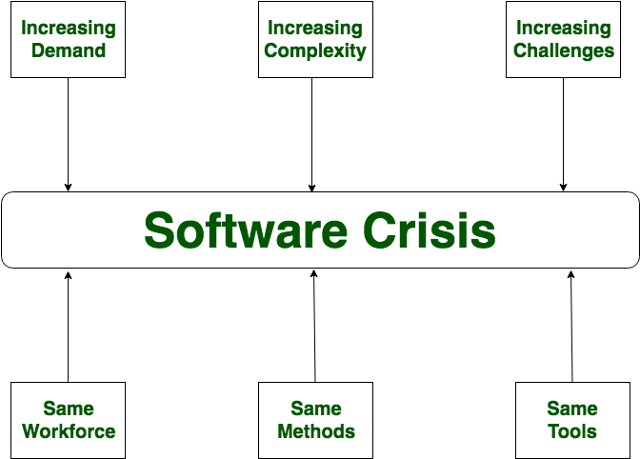
Software Crisis
Software Crisis is a term used in computer science for the difficulty of writing useful and efficient computer programs in the required time.

Slide 10
Software Crisis
There is no single solution to the crisis.
Following issues need to be addressed to face this crisis:
How to represent real-life entities of problems in system design
How to ensure reusability and extensibility of modules
How to develop module which can tolerant to any change in future
How to improve software productivity and decrease software cost
How to improve quality of software
How to manage time schedules

Slide 11
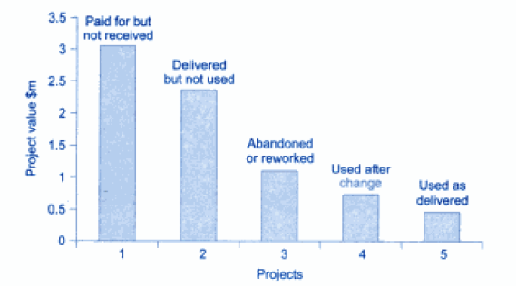
Software Crisis(Cont…)
Fig: The State of US defense projects

Slide 12
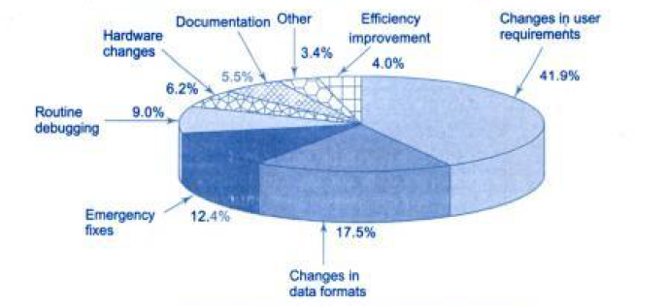
Breakdown of maintenance costs

Slide 13
Main Quality Issues
Correctness : software behaves exactly as intended
Maintainability : easy to repair, improve the software
Reusability : reuse of existing programs or software components
Interoperability : exchange of data with other software
Portability: usability of the same software in different environments
Security : protection of software against malicious attack so that the software continues to function correctly under such potential risks
Openness: software and its source code should be free for use
User friendliness : Easy to use
Note: Selection and use of proper software tools would resolve some of these issues.

Slide 14
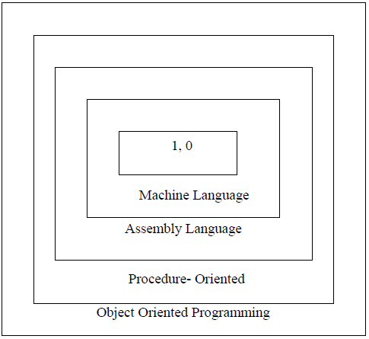
Software Evolution

Slide 15
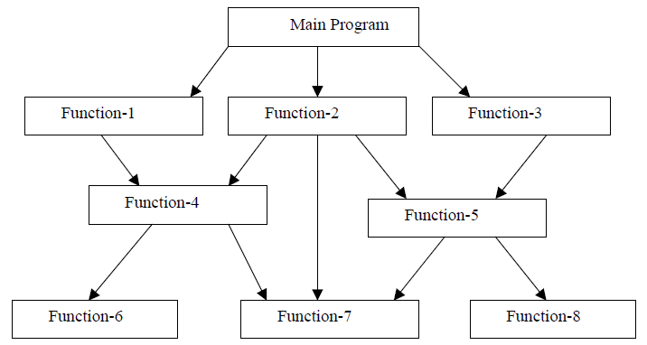
Procedure -Oriented Programming(POP)
In POP the problem is viewed as the sequence of things to be done such as reading, calculating and printing.
The primary focus is on functions.
Examples of POP languages : C, Pascal, FORTRAN
Fig. Typical structure of procedural oriented programs

Slide 16
Characteristics of (POP)
Emphasis is on doing things (algorithms).
Large programs are divided into smaller programs known as functions.
Most of the functions share global data.
Data move openly around the system from function to function.
Functions transform data from one form to another.
Employs top-down approach in program design.

Slide 17
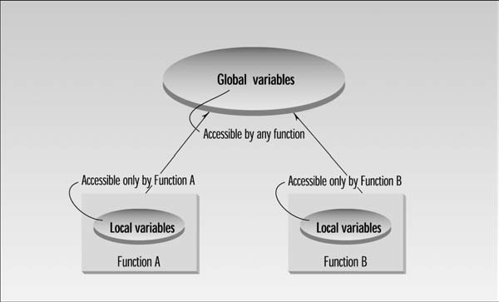
Problems with POP
POP is not suitable for large complex software.
There are two main problems:
1. First, functions have unrestricted access to global data.

Slide 18
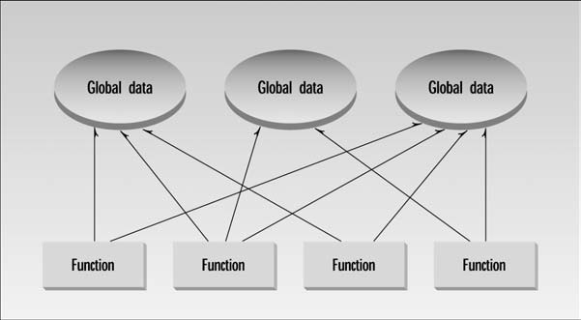
Problems with Structured Programming
Fig: The procedural paradigm

Slide 19
Problems with Structured Programming
2. Not suitable for Real-World Modeling:
The second—and more important—problem with the procedural paradigm is that its arrangement of separate data and functions does a poor job of modeling things in the real world.
In the physical world we deal with objects such as people and cars. Such objects aren’t like data and they aren’t like functions.
Complex real-world objects have both attributes and behavior.
Attributes: Examples of attributes (sometimes called characteristics) are, for people, eye color and job title; and, for cars, horsepower and number of doors. Attributes in the real world are equivalent to data in a program
Behavior: Behavior is something a real-world object does in response to some stimulus. If you apply the brakes in a car, it will generally stop. Saying something and stopping are examples of behavior.
Behavior is like a function: you call a function to do something. So neither data nor functions, by themselves, model real-world objects effectively.

Slide 20
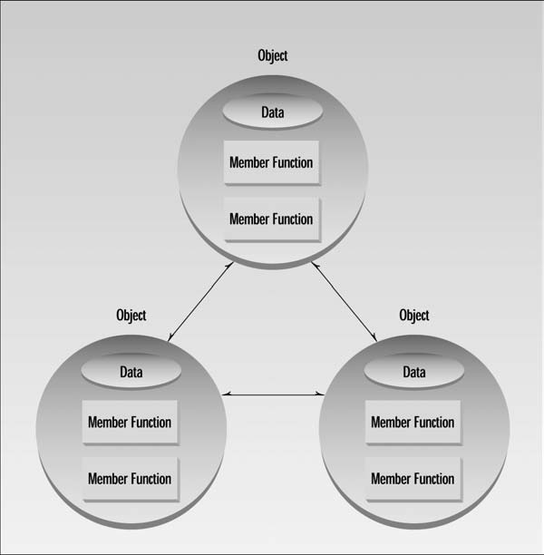
Object-oriented programming paradigm
Object-oriented programming (OOP) is a programming paradigm based on the concept of "objects", which may contain data, often known as attributes; and code, in the form of procedures, often known as methods.

Slide 21
Characteristics of OOP
Class
Object
Encapsulation
Data Hiding
Data Abstraction
Inheritance
Polymorphism

Slide 22
1. Class:
It is a user-defined data type that defines the abstract characteristics of an object, that includes attributes (data) and methods or functions.
A class serves as a plan, or blueprint.
It specifies what data and what functions will be included in objects of that class.
Defining the class doesn’t create any objects, just as the mere existence of data type int doesn’t create any variables.

Slide 23
2. Objects:
Objects are the basic run time entities in an object-oriented system which refers to a particular instance of a class.
The object can be a combination of data members and member functions.
What kinds of things become objects in object-oriented programs?
The answer to this is limited only by your imagination.
Four Categories may be:
Physical objects
Computer related objects
Data storage
Human entity
Class | Object
Fruit | apple
Vehicle | car
Animal | cow

Slide 24
Real World Objects Examples
Physical objects | Elements of the computer-user environment | Data-storage constructs | Human entities
Automobiles in a traffic-flow simulation | Windows | Customized arrays | Employees
Electrical components in a circuit-design program | Menus | Stacks | Students
Countries in an economics model | Graphics objects (lines, rectangles, circles) | Linked lists | Customers
Aircraft in an air traffic control system | The mouse, keyboard, disk drives, printer | Binary trees | Salespeople

Slide 25
POP vs OOP example
int main()
{
int l,b,h;
Calc_Floor_Area(l,b);
Calc_4wall_Area(l,b,h);
}
class room
{
int l,b,h;
public:
Calc_Floor_Area();
Calc_4wall_Area();
};

Slide 26
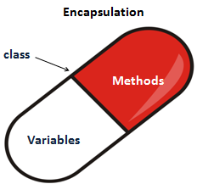
Encapsulation and data hiding
3.Encapsulation is a process of combining data members and functions in a single unit called class.
Due to encapsulation the data is not accessible to the outside world, and only those functions which are wrapped in the class can access it.
4. Data hiding is a process of hiding or preventing data from accidental alteration.

Slide 27
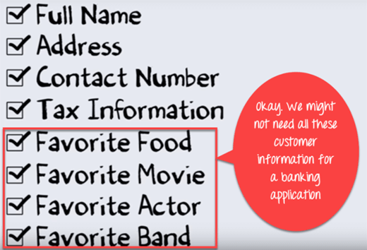
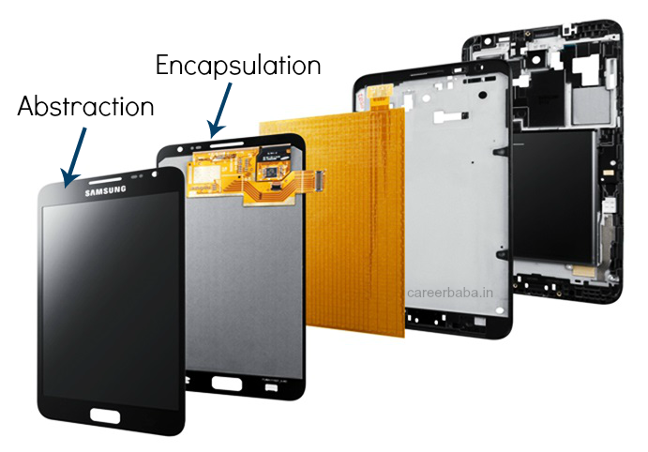
5. Data Abstraction:
Providing only essential information to the outside world and hiding their background details.
Class provides sufficient public methods to the outside world to access / manipulate data of object.
In other words, C++ class provides a way by which outside world can interact with object without actually knowing how class has been implemented internally.

Slide 28
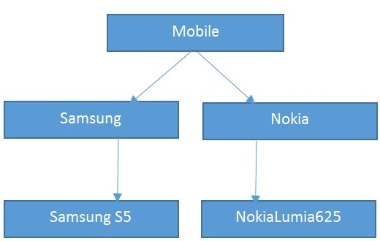
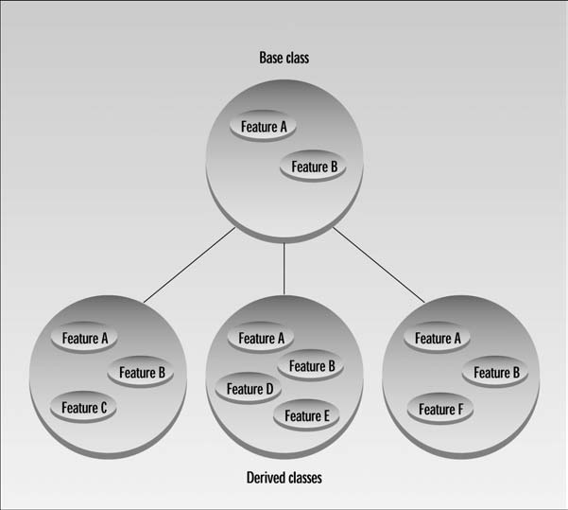
6. Inheritance
Inheritance is the process by which objects of one class acquires the properties of objects of another class.

Slide 29
Cont…
Once a class has been written, created, and debugged, it can be distributed to other programmers for use in their own programs. This is called reusability.
It is similar to the way a library of functions in a procedural language can be incorporated into different programs.
In OOP, the concept of inheritance provides an important extension to the idea of reusability.
For example, you might have written (or purchased from someone else) a class that creates a menu system, such that used in Windows or other Graphic User Interfaces (GUIs). This class works fine, and you don’t want to change it, but you want to add the capability to make some menu entries flash on and off. To do this, you simply create a new class that inherits all the capabilities of the existing one but adds flashing menu entries.

Slide 30
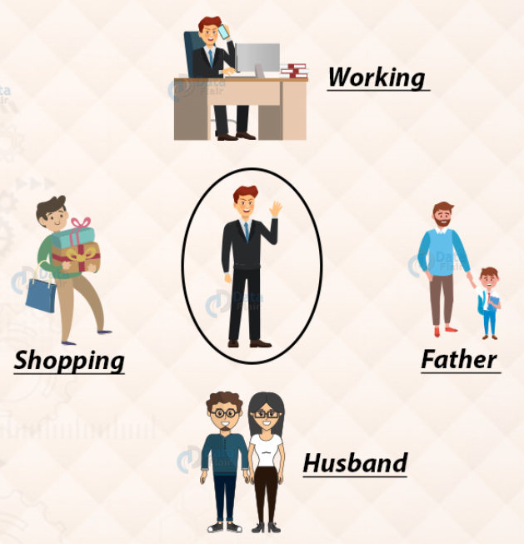
7. Polymorphism
Poly = many and Morph = form
So polymorphism is the ability (in programming) to present the same interface for differing underlying forms (data types).

Slide 31
Type of polymorphism
Polymorphism
Compile time polymorphism
Run time polymorphism
Function Overloading
Operator Overloading
Virtual functions
Function overloading: When there are multiple functions with same name but different parameters
Operator overloading: The existing operators work for user-defined types like objects and structures

Slide 32
Advantages of Object-Oriented
Programming?
OOP makes it easy to maintain and modify existing code
Objects created for Object-Oriented Programs can easily be reused in other programs. Because it lets you write a set of functions, then expand them in different directions without changing or copying them in any way. (Inheritance)
Once an Object is created, knowledge of its implementation is not necessary for its use- Security(abstraction).
Objects have the ability to hide certain parts of themselves from programmers (Data hiding). This prevents programmers from tampering with values they shouldn't. For example, a programmer (or another program) cannot set the width of a window to -400.
In addition, once a program reaches a certain size, Object Oriented Programs are actually easier to program than non-Object Oriented ones.
It is suitable for real world problems and real world works
It allows you to have many different functions, all with the same name, all doing the same job, but on different data. (Polymorphism)

Slide 33
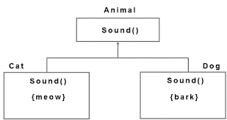
Summary
Four Fundamentals of OOPS:
i) Encapsulation
ii) Inheritance
iii) Polymorphism
iv) Abstraction

Slide 34
Questions?
1. Protecting data from access by unauthorized functions is called _____.
2. Bundling data and functions together is called _____.
Reference
https://www.youtube.com/watch?v=p3H-53kzMuA&t=1988s

